Slide 1
VPNs

Slide 2
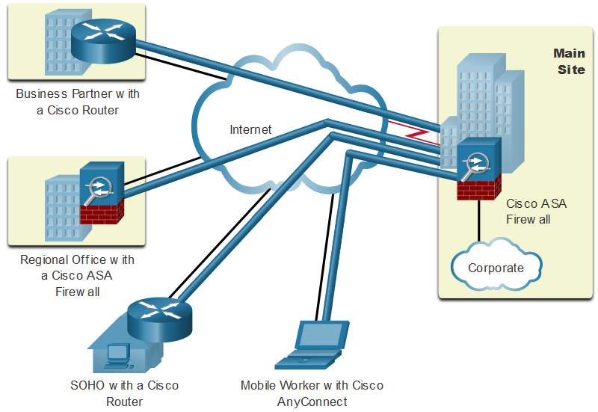
VPN Overview
Virtual Private Networks
To secure network traffic between sites and users, organizations use virtual private networks (VPNs) to create end-to-end private network connections. A VPN is virtual in that it carries information within a private network, but that information is transported over a public network. A VPN is private in that the traffic is encrypted to keep the data confidential while it is transported across the public network. The figure shows a collection of various types of VPNs managed by an enterprise’s main site. The tunnel enables remote sites and users to access main site’s network resources securely.

Slide 3
VPN Overview
VPN Benefits
Modern VPNs now support encryption features, such as Internet Protocol Security (IPsec) and Secure Sockets Layer (SSL) VPNs to secure network traffic between sites.
Major benefits of VPNs are shown in the table.
Benefit | Description
Cost Savings | With the advent of cost-effective, high-bandwidth technologies, organizations can use VPNs to reduce their connectivity costs while simultaneously increasing remote connection bandwidth.
Security | VPNs provide the highest level of security available, by using advanced encryption and authentication protocols that protect data from unauthorized access.
Scalability | VPNs allow organizations to use the internet, making it easy to add new users without adding significant infrastructure.
Compatibility | VPNs can be implemented across a wide variety of WAN link options including all the popular broadband technologies. Remote workers can take advantage of these high-speed connections to gain secure access to their corporate networks.

Slide 4
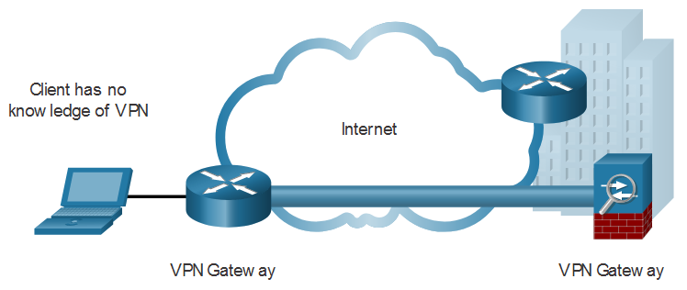
VPN Topologies
Site-to-Site and Remote-Access VPNs
A site-to-site VPN is created when VPN terminating devices, also called VPN gateways, are preconfigured with information to establish a secure tunnel. VPN traffic is only encrypted between these devices. Internal hosts have no knowledge that a VPN is being used.

Slide 5
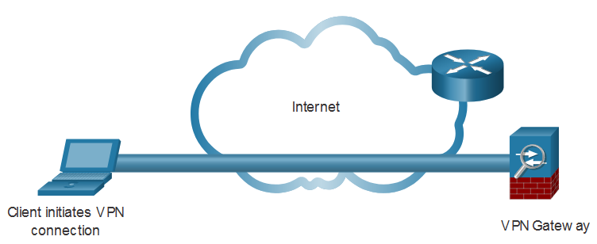
VPN Topologies
Site-to-Site and Remote-Access VPNs (Cont.)
A remote-access VPN is dynamically created to establish a secure connection between a client and a VPN terminating device. For example, a remote access SSL VPN is used when you check your banking information online.

Slide 6
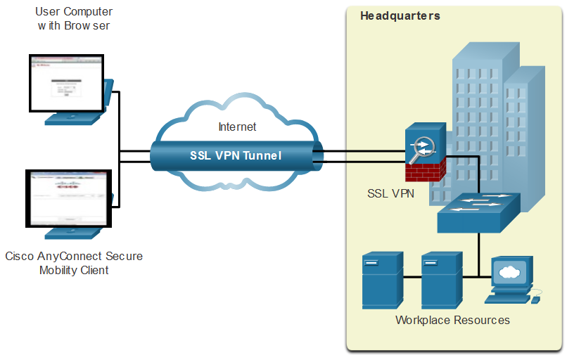
VPN Topologies
Remote-Access VPNs
Remote-access VPNs are typically enabled dynamically by the user when required. Remote access VPNs can be created using either IPsec or SSL. A remote user must initiate a remote access VPN connection. The figure displays two ways that a remote user can initiate a remote access VPN connection: clientless VPN and client-based VPN.

Slide 7
VPN Topologies
SSL VPNs
SSL uses the public key infrastructure and digital certificates to authenticate peers. Both IPsec and SSL VPN technologies offer access to virtually any network application or resource. However, when security is an issue, IPsec is the superior choice. If support and ease of deployment are the primary issues, consider SSL. The type of VPN method implemented is based on the access requirements of the users and the organization’s IT processes. The table compares IPsec and SSL remote access deployments.
Feature | IPsec | SSL
Applications supported | Extensive - All IP-based applications are supported. | Limited - Only web-based applications and file sharing are supported.
Authentication strength | Strong - Uses two-way authentication with shared keys or digital certificates. | Moderate - Using one-way or two-way authentication.
Encryption strength | Strong - Uses key lengths from 56 bits to 256 bits. | Moderate to strong - With key lengths from 40 bits to 256 bits.
Connection complexity | Medium - Because it requires a VPN client pre-installed on a host. | Low - It only requires a web browser on a host.
Connection option | Limited - Only specific devices with specific configurations can connect. | Extensive - Any device with a web browser can connect.
Notes:
IPsec: IPsec operates at the network layer (Layer 3) of the OSI model, providing security at the IP packet level. It can secure any IP-based communication, including protocols like IPv4 and IPv6.
SSL/TLS: SSL/TLS operates at the transport layer (Layer 4) of the OSI model, providing security at the application layer. It primarily secures application-level protocols such as HTTP, SMTP, and FTP.
IPsec: IPsec offers a broad range of security features, including encryption, authentication, and integrity protection. It can be used to establish site-to-site VPNs (Virtual Private Networks) or remote access VPNs.
SSL/TLS: SSL/TLS primarily focuses on securing data in transit using encryption. It ensures confidentiality, integrity, and authenticity of the communication. It is commonly used for securing web-based applications, such as HTTPS.

Slide 8
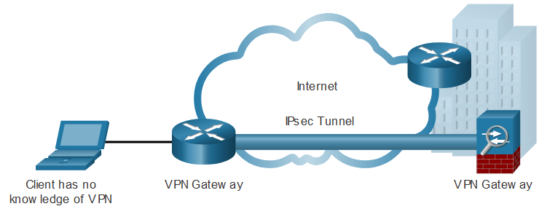
VPN Topologies
Site-to-Site IPsec VPNs
The VPN gateway encapsulates and encrypts outbound traffic. It then sends the traffic through a VPN tunnel over the internet to a VPN gateway at the target site. Upon receipt, the receiving VPN gateway strips the headers, decrypts the content, and relays the packet toward the target host inside its private network. Site-to-site VPNs are typically created and secured using IP security (IPsec).

Slide 9
IPsec Overview

Slide 10
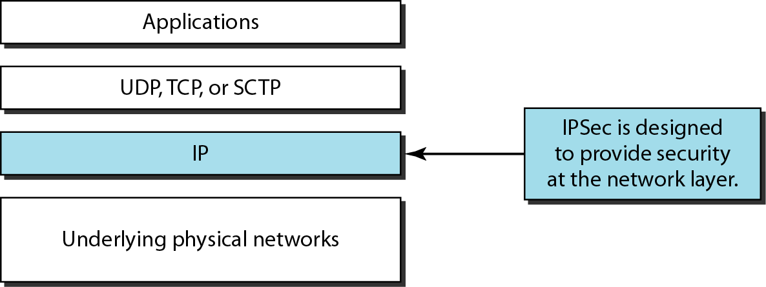
Figure 32.2 TCP/IP protocol suite and IPSec

Slide 11
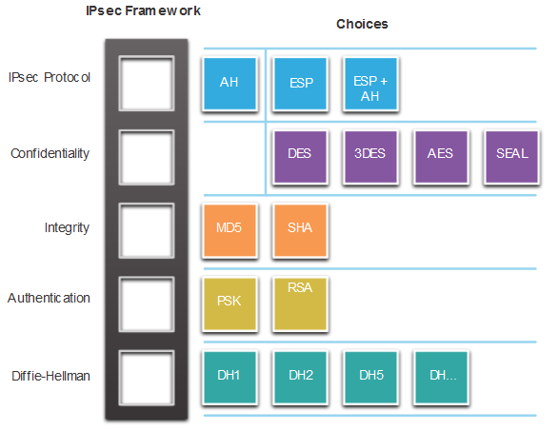
IPsec Overview
IPsec Technologies
Using the IPsec framework, IPsec provides these essential security functions:
Confidentiality - IPsec uses encryption algorithms to prevent cybercriminals from reading the packet contents.
Integrity - IPsec uses hashing algorithms to ensure that packets have not been altered between source and destination.
Origin authentication - IPsec uses the Internet Key Exchange (IKE) protocol to authenticate source and destination. Methods of authentication including using pre-shared keys (passwords), digital certificates, or RSA certificates.
Diffie-Hellman - Secure key exchange typically using various groups of the DH algorithm.

Slide 12
IPsec Overview
IPsec Technologies (Cont.)
The IPsec security functions are list in the table.
IPsec Function | Description
IPsec Protocol | The choices for IPsec Protocol include Authentication Header (AH) or Encapsulation Security Protocol (ESP). AH authenticates the Layer 3 packet. ESP encrypts the Layer 3 packet. Note: ESP+AH is rarely used as this combination will not successfully traverse a NAT device.
Confidentiality | Encryption ensures confidentiality of the Layer 3 packet. Choices include Data Encryption Standard (DES), Triple DES (3DES), Advanced Encryption Standard (AES), or Software-Optimized Encryption Algorithm (SEAL).
Integrity | Ensures that data arrives unchanged at the destination using a hash algorithm, such as message-digest 5 (MD5) or Secure Hash Algorithm (SHA).
Authentication | IPsec uses Internet Key Exchange (IKE) to authenticate users and devices that can carry out communication independently. IKE uses several types of authentication, including username and password, one-time password, biometrics, pre-shared keys (PSKs), and digital certificates using the Rivest, Shamir, and Adleman (RSA) algorithm.
Diffie-Hellman | IPsec uses the DH algorithm to provide a public key exchange method for two peers to establish a shared secret key. There are several different groups to choose from including DH14, 15, 16 and DH 19, 20, 21 and 24. DH1, 2 and 5 are no longer recommended.

Slide 13
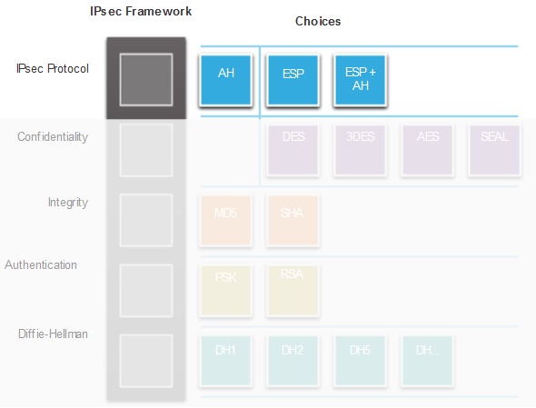
IPsec Overview
IPsec Protocol Encapsulation
Choosing the IPsec protocol encapsulation is the first building block of the framework. IPsec encapsulates packets using Authentication Header (AH) or Encapsulation Security Protocol (ESP). The choice of AH or ESP establishes which other building blocks are available. AH is appropriate only when confidentiality is not required or permitted. ESP provides both confidentiality and authentication.

Slide 14
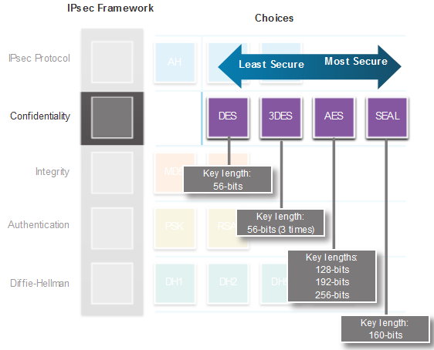
IPsec Overview
Confidentiality
Confidentiality is achieved by encrypting the data. The degree of confidentiality depends on the encryption algorithm and the length of the key used in the encryption algorithm. The shorter the key, the easier it is to break.
DES uses a 56-bit key and should be avoided.
3DES uses three 56-bit encryption keys per 64-bit block.
AES offers three different key lengths: 128 bits, 192 bits, and 256 bits.
SEAL is a stream cipher, encrypting data continuously. It uses a 160-bit key.

Slide 15
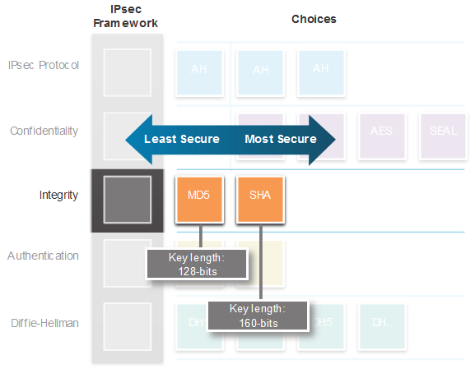
IPsec Overview
Integrity
Data integrity means that the data that is received is exactly the same data that was sent.
Message-Digest 5 (MD5) uses a 128-bit shared-secret key. The variable-length message and 128-bit shared-secret key are combined and run through the HMAC-MD5 hash algorithm producing a 128-bit hash.
The Secure Hash Algorithm (SHA) uses a 160-bit secret key. The variable-length message and 160-bit shared-secret key are combined and run through the HMAC-SHA-1 algorithm producing a 160-bit hash.

Slide 16
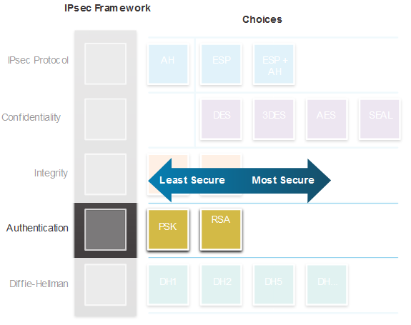
IPsec Overview
Authentication
When conducting business long distance, the device on the other end of the VPN tunnel must be authenticated before the communication path is considered secure.
A pre-shared secret key (PSK) value is entered into each peer manually. The PSK is combined with other information to form the authentication key.
Rivest, Shamir, and Adleman (RSA) authentication uses digital certificates to authenticate peers.

Slide 17
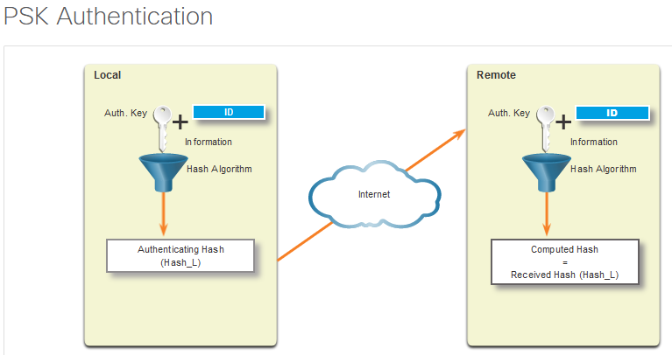
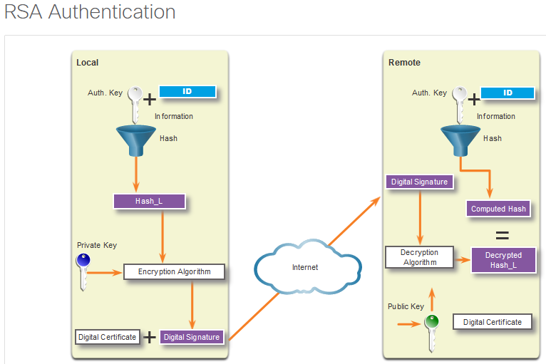
IPsec Overview
Authentication (Cont.)

Slide 18
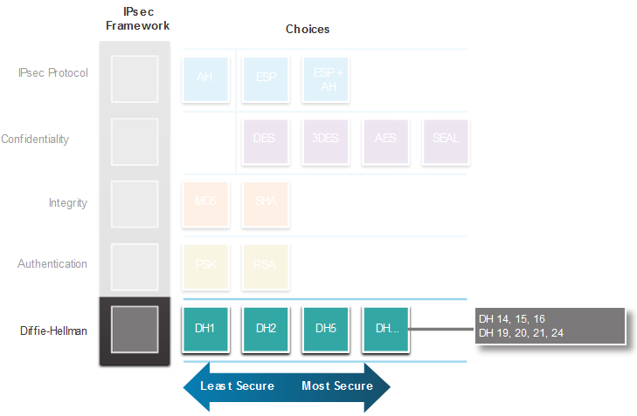
IPsec Overview
Secure Key Exchange with Diffie-Hellman
Encryption algorithms require a symmetric, shared secret key to perform encryption and decryption. How do the encrypting and decrypting devices get the shared secret key? The easiest key exchange method is to use a public key exchange method, such as Diffie-Hellman (DH). DH provides a way for two peers to establish a shared secret key that only they know, even though they are communicating over an insecure channel. Variations of the DH key exchange are specified as DH groups. The DH group you choose must be strong enough, or have enough bits, to protect the IPsec keys during negotiation.

Slide 19

IPsec Protocols
IPsec Protocol Overview
The two main IPsec protocols are Authentication Header (AH) and Encapsulation Security Protocol (ESP). The IPsec protocol is the first building block of the framework. The choice of AH or ESP establishes which other building blocks are available. AH uses IP protocol 51 and is appropriate only when confidentiality is not required or permitted. It provides data authentication and integrity, but it does not provide data confidentiality (encryption). All text is transported unencrypted. ESP uses IP protocol 50 and provides both confidentiality and authentication. Authentication provides data origin authentication and data integrity.

Slide 20
IPsec Protocols
Authentication Header
The AH function is applied to the entire packet, except for any IP header fields that normally change in transit. Fields that normally change during transit are called mutable fields. For example, the Time to Live (TTL) field is considered mutable because routers modify this field. The AH process occurs in this order:
The IP header and data payload are hashed using the shared secret key.
The hash builds a new AH header, which is inserted into the original packet.
The new packet is transmitted to the IPsec peer router.
The peer router hashes the IP header and data payload using the shared secret key, extracts the transmitted hash from the AH header, and compares the two hashes.
The hashes must match exactly. If one bit is changed in the transmitted packet, the hash output on the received packet changes and the AH header will not match. AH supports MD5 and SHA algorithms.

Slide 21
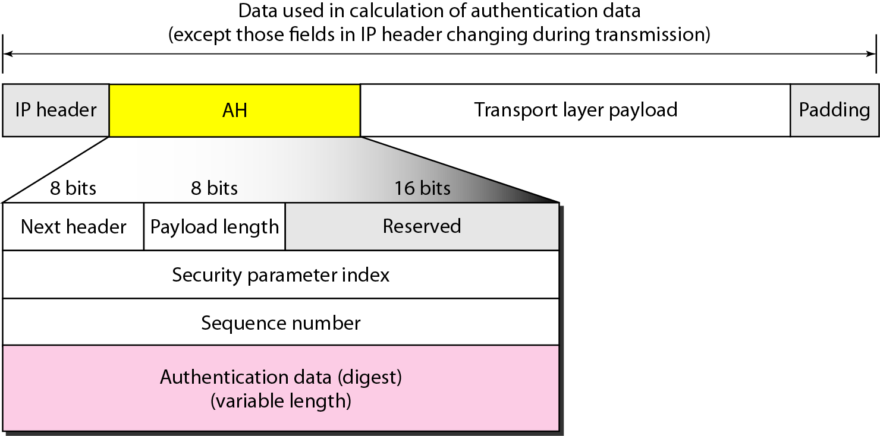
Figure 32.6 Authentication Header (AH) Protocol in transport mode

Slide 22
IPsec Protocols
Encapsulation Security Protocol
If ESP is selected as the IPsec protocol, an encryption algorithm must also be selected. The default algorithm for IPsec is 56-bit DES. ESP can also provide integrity and authentication. First, the payload is encrypted. Next, the encrypted payload is sent through a hash algorithm. The hash provides authentication and data integrity for the data payload.
Optionally, ESP can also enforce anti-replay protection which verifies that each packet is unique and is not duplicated. This protection ensures that a hacker cannot intercept packets and insert changed packets into the data stream. Anti-replay works by keeping track of packet sequence numbers and using a sliding window on the destination end.
When a connection is established between a source and destination, their counters are initialized at zero. Each time a packet is sent, a sequence number is appended to the packet by the source. The destination uses the sliding window to determine which sequence numbers are expected. The destination verifies that the sequence number of the packet is not duplicated and is received in the correct order.

Slide 23
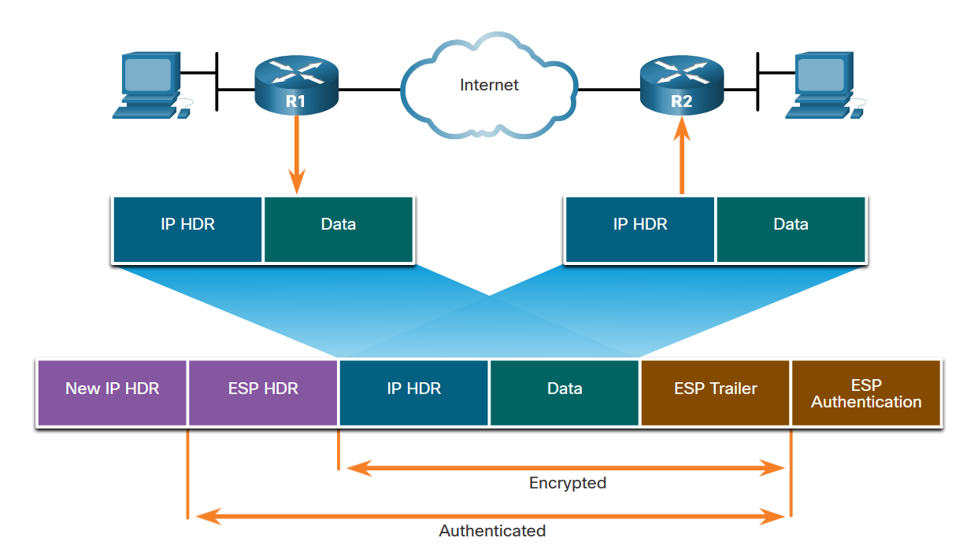
IPsec Protocols
ESP Encrypts and Authenticates
When both authentication and encryption are selected, encryption is performed first. One reason for this order of processing is that it facilitates rapid detection and rejection of replayed or bogus packets by the receiving device. Prior to decrypting the packet, the receiver can authenticate inbound packets.
IPsec was initially established to provide security for IPv6 packets. Therefore, the IPsec implementations for IPv4 and IPv6 are similar as far as the standards are concerned. In IPv4, AH and ESP are IP protocol headers. IPv6 uses the extension headers with a next-header value of 50 for ESP and 51 for AH.

Slide 24
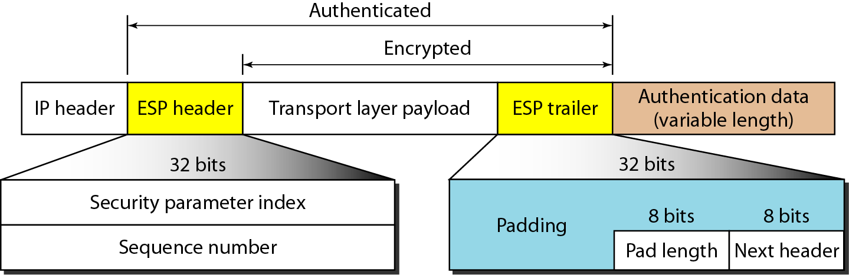
Figure 32.7 Encapsulating Security Payload (ESP) Protocol in transport mode
Note the difference between the authentication data in AH and ESP. In AH, part of the IP header is included in the calculation of the authentication data; in ESP, it is not.

Slide 25
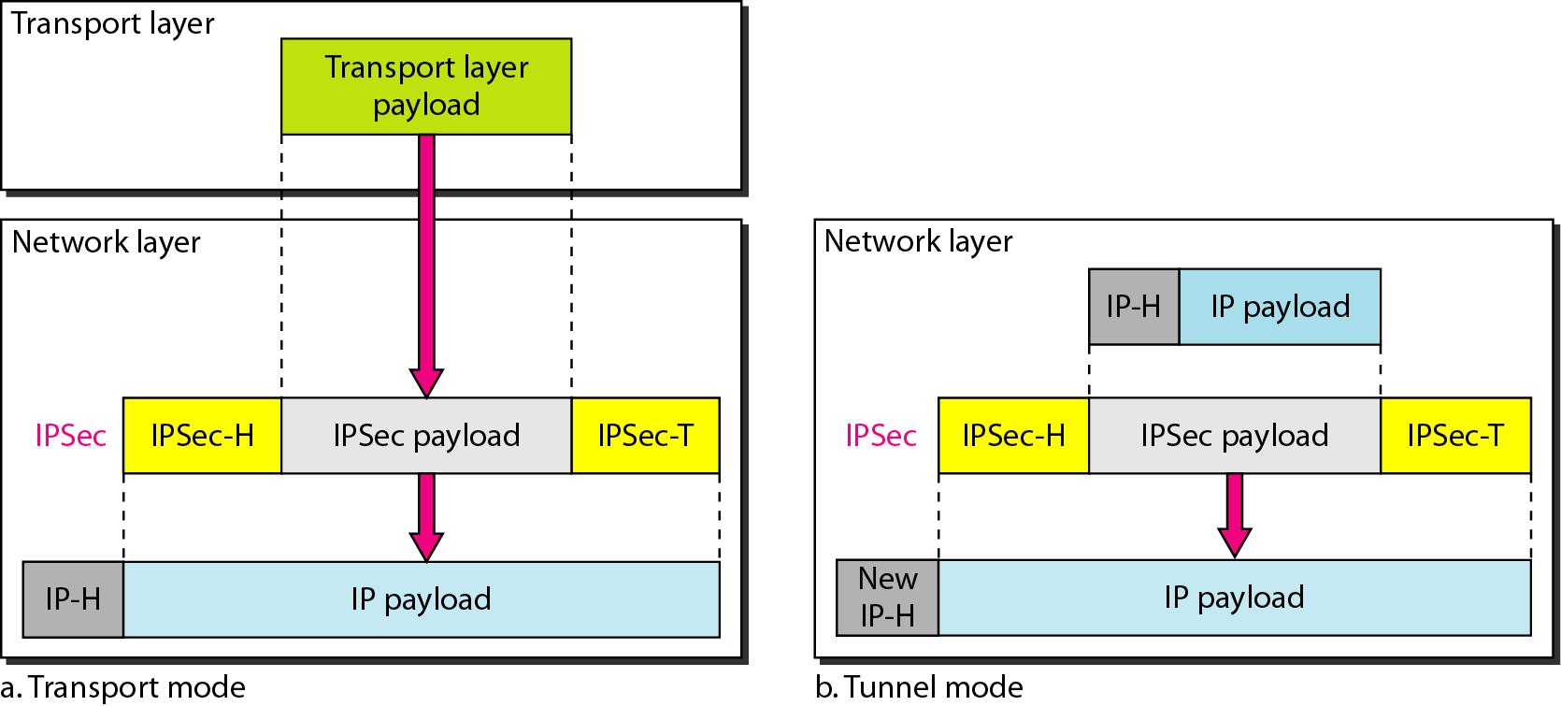
Figure 32.3 Transport mode and tunnel modes of IPSec protocol

Slide 26
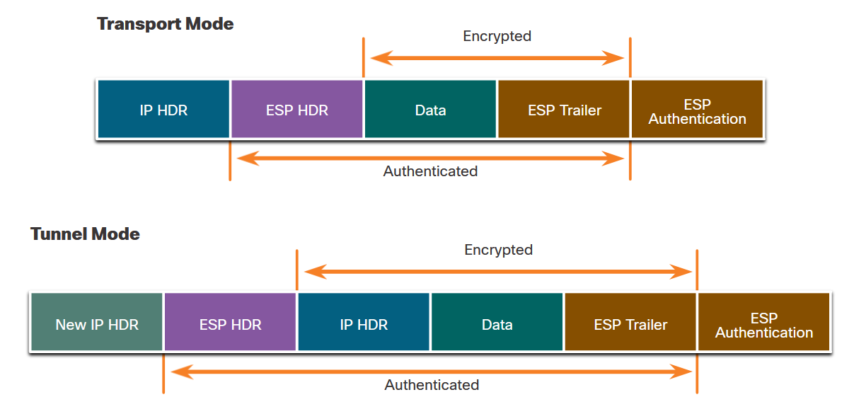
IPsec Protocols
Transport and Tunnel Modes
Transport Mode - In transport mode, security is provided only for the transport layer of the OSI model and above. Transport mode protects the payload of the packet but leaves the original IP address in plaintext. The original IP address is used to route the packet through the internet. ESP transport mode is used between hosts.
Tunnel Mode - Tunnel mode provides security for the complete original IP packet. The original IP packet is encrypted and then it is encapsulated in another IP packet. This is known as IP-in-IP encryption. The IP address on the outside IP packet is used to route the packet through the internet.

Slide 27
Internet Key Exchange

Slide 28
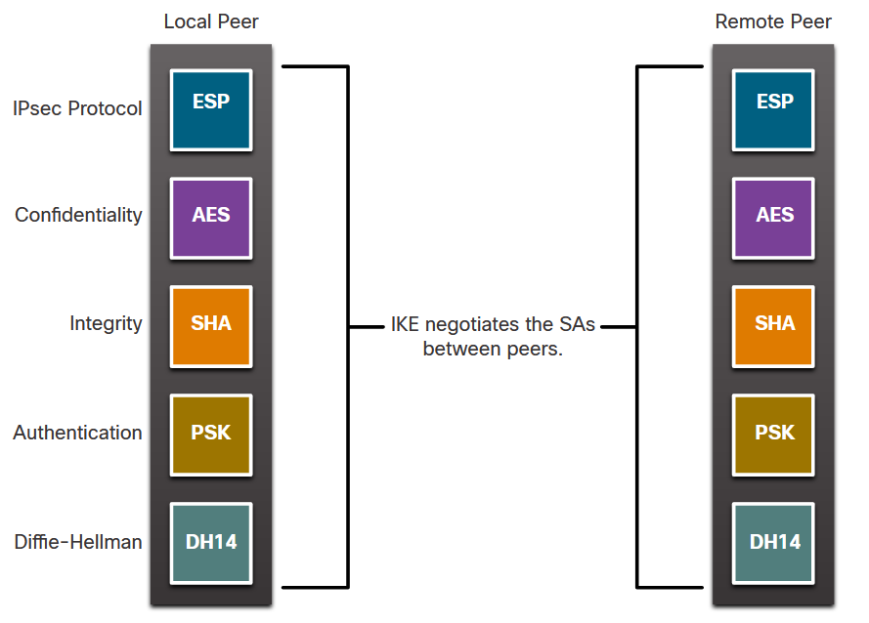
Internet Key Exchange
The IKE Protocol
IKE enhances IPsec by adding features and simplifies configuration for the IPsec standard.
IKE is a hybrid protocol that implements key exchange protocols inside the Internet Security Association Key Management Protocol (ISAKMP) framework.
Instead of transmitting keys directly across a network, IKE calculates shared keys based on the exchange of a series of data packets.
UDP port 500 packets must be permitted on any IP interface that is connecting a security gateway peer.

Slide 29
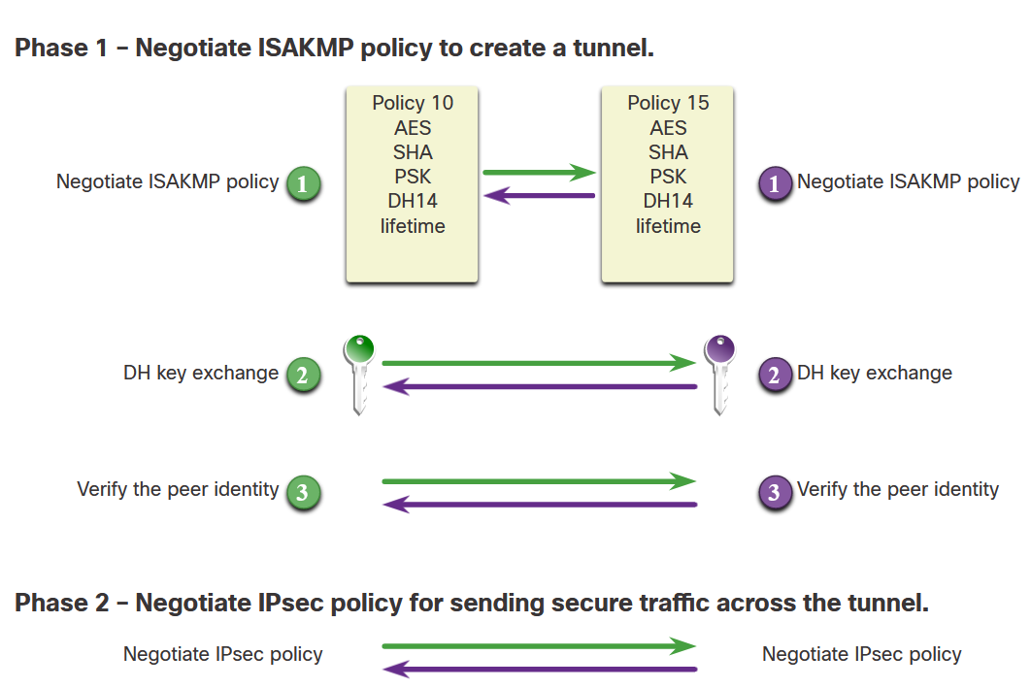
Internet Key Exchange
Phase 1 and 2 Key Negotiation
IKE uses ISAKMP for phase 1 and phase 2 of key negotiation. Phase 1 negotiates a security association (a key) between two IKE peers. The key negotiated in phase 1 enables IKE peers to communicate securely in phase 2. During phase 2 negotiation, IKE establishes keys (security associations) for other applications, such as IPsec.
In Phase 1, two IPsec peers perform the initial negotiation of SAs. The basic purpose of Phase 1 is to negotiate ISAKMP policy, authenticate the peers, and set up a secure tunnel between the peers. This tunnel will then be used in Phase 2 to negotiate the IPsec policy.

Slide 30
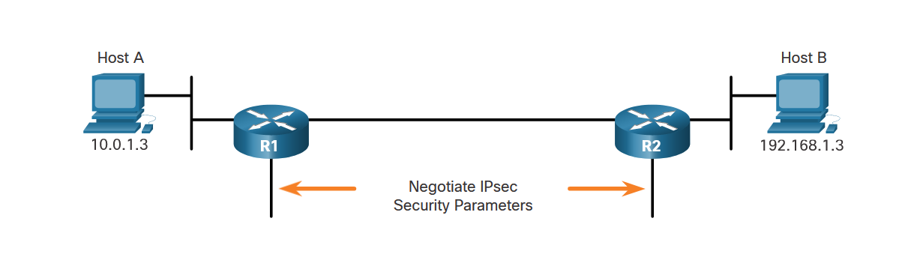
Internet Key Exchange
Phase 2: Negotiating SAs
IKE Phase 2 is called quick mode and can only occur after IKE has established a secure tunnel in Phase 1. Quick mode negotiates the IKE Phase 2 SAs. In this phase, the SAs that IPsec uses are unidirectional; therefore, a separate key exchange is required for each data flow.

Slide 31
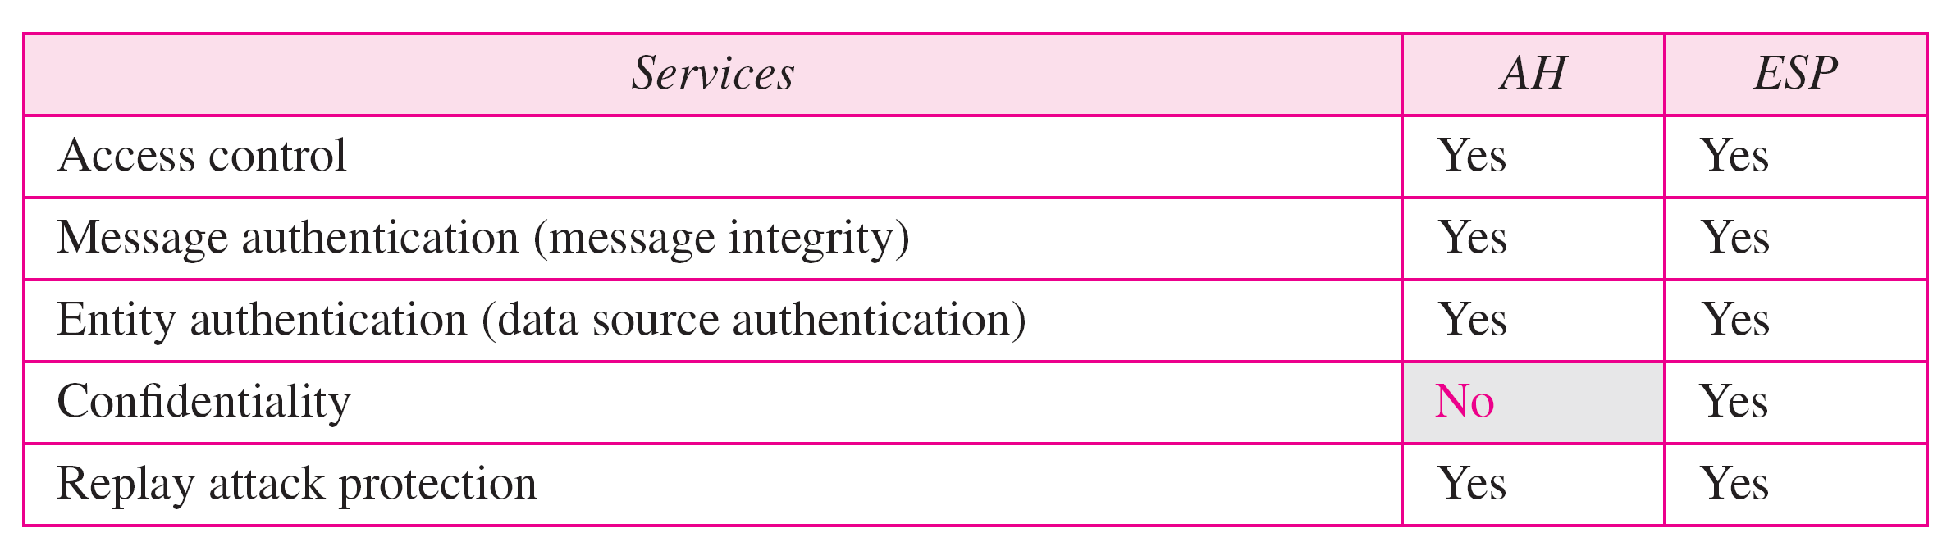
Table 32.1 IPSec services
Replay Attack Protection In both protocols, the replay attack is prevented by using sequence numbers and a sliding receiver window.

Slide 32
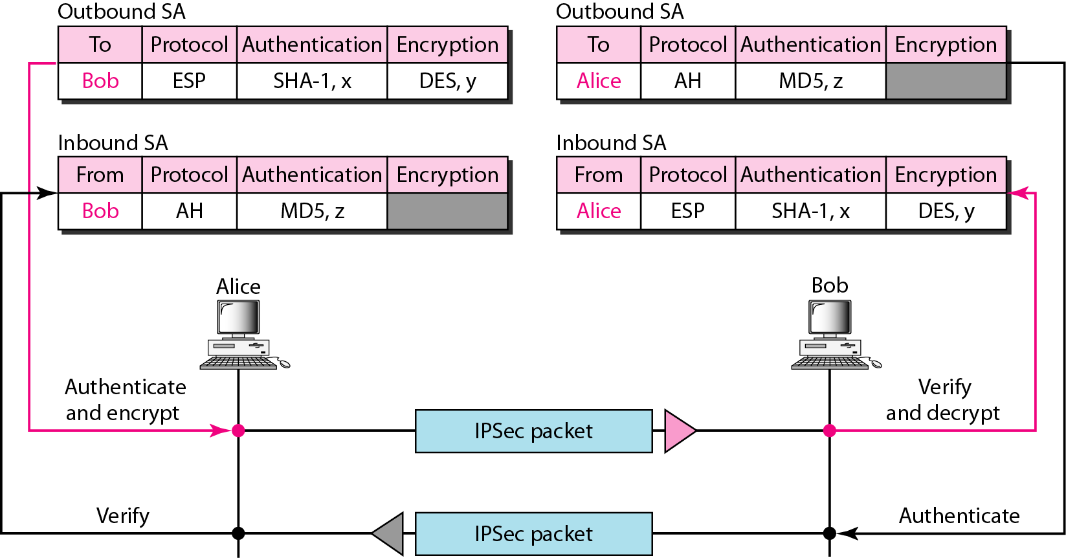
Figure 32.8 Simple inbound and outbound security associations

Slide 33
Adaptive Security Appliance (ASA)

Slide 34
ASA Firewall
ASA is a security appliance made by Cisco that provides firewall, VPN, and other security services for network traffic. ASA stands for Adaptive Security Appliance.
Cisco ASA offers multiple features, including:
1. Firewall protection: It provides advanced firewall features to protect against unauthorized access, including stateful inspection, application-layer inspection, and access control.
2. Virtual Private Network (VPN) connectivity: It offers secure remote access to corporate resources through VPN connections, including IPsec and SSL VPNs.
3. Intrusion Prevention System (IPS): It includes an IPS module to provide additional protection against known and unknown attacks.
4. Web Security: It can inspect web traffic for malware and other security threats.
5. Network Address Translation (NAT): It provides a NAT feature to enable private IP addressing to connect to the internet.

Slide 35
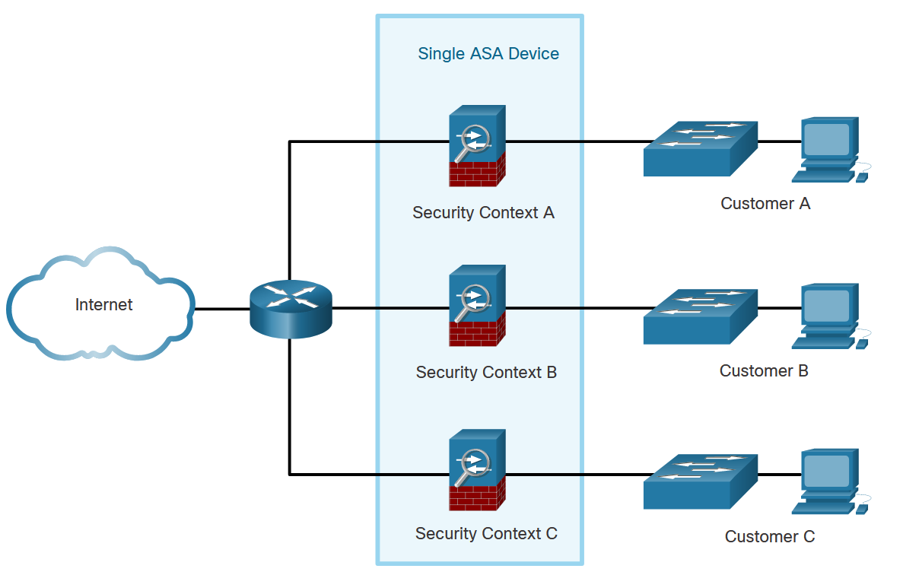
ASA Solutions
Advanced ASA Firewall Features
A single ASA can be partitioned into multiple virtual devices, as illustrated here. Each virtual device is called a security context. Each context is an independent device, with its own security policy, interfaces, and administrators. Multiple contexts are similar to having multiple standalone devices. Many features are supported in multiple context modes, including routing tables, firewall features, IPS, and management. Some features are not supported, including VPN and dynamic routing protocols.

Slide 36
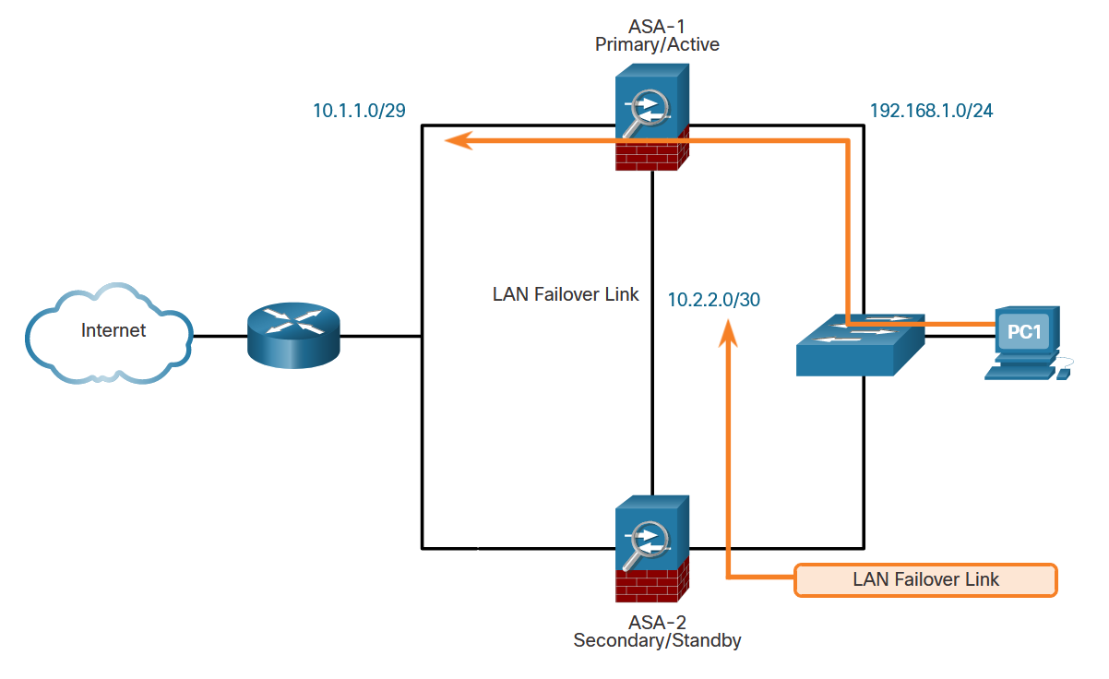
ASA Solutions
Advanced ASA Firewall Features (Cont.)
As shown here, two identical ASAs can be paired into an active / standby failover configuration to provide device redundancy. Both platforms must be identical in software, licensing, memory, and interfaces, including the Security Services Module (SSM). In the example, ASA-1 is the primary/active forwarding device and traffic leaving PC-1 takes the preferred path using ASA-1. ASA-1 and ASA-2 monitor each other using the LAN failover link. If ASA-1 fails, then ASA-2 would immediately assume the primary role and become active.

Slide 37
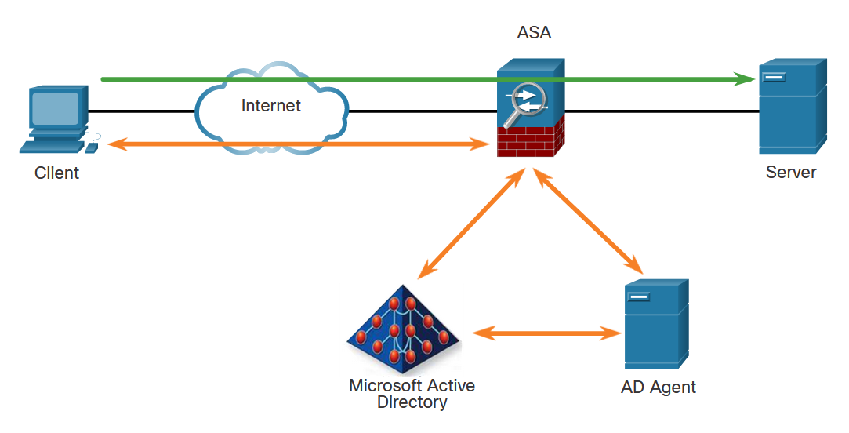
ASA Solutions
Advanced ASA Firewall Features (Cont.)
The ASA provides optional, granular access control based on an association of IP addresses to Windows Active Directory login information. For example, in the figure, when a client attempts to access the server resources, it must first be authenticated using the Microsoft Active Directory Identity-based firewall services. These services enhance the existing access control and security policy mechanisms by allowing users, or groups, to be specified in place of source IP addresses. Identity-based security policies can be interleaved without restriction between traditional IP address-based rules.

Slide 38
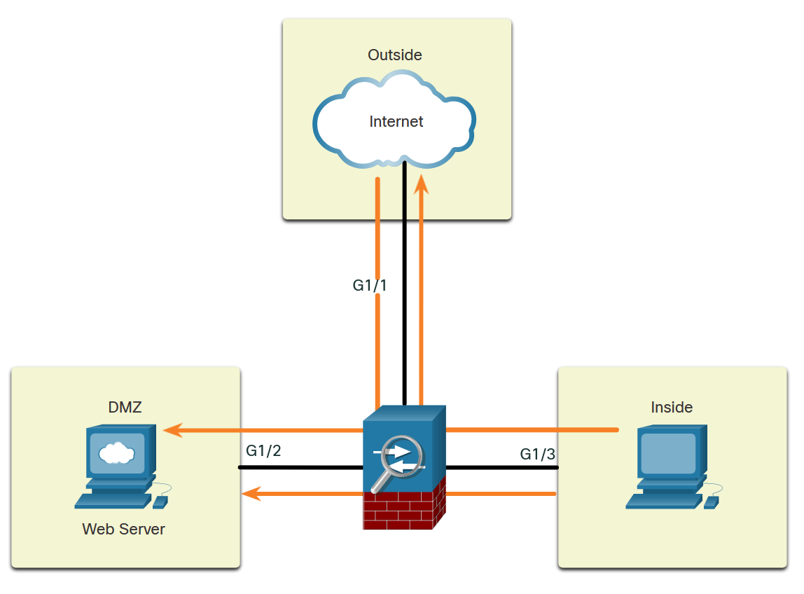
ASA Solutions
Review of Firewalls in Network Design
When discussing networks that are connected to a firewall, there are some general terms to consider:
Outside network - The network/zone that is outside the protection of the firewall.
Inside network - The network/zone that is protected and behind the firewall.
DMZ - The demilitarized zone that allows both inside and outside users access to protected network resources.
Firewalls protect inside networks from unauthorized access by users who are on an outside network. They also protect inside network users from each other. For example, by creating zones, an administrator can keep the network that is hosting the accounting servers separate from other networks in an organization.
The figure illustrates how these zones interact for permitted traffic:
Traffic originating from the inside network going to the outside network is permitted.
Traffic originating from the inside network going to the DMZ network is permitted.
Traffic originating from the outside network going to the DMZ network is selectively permitted.

Slide 39
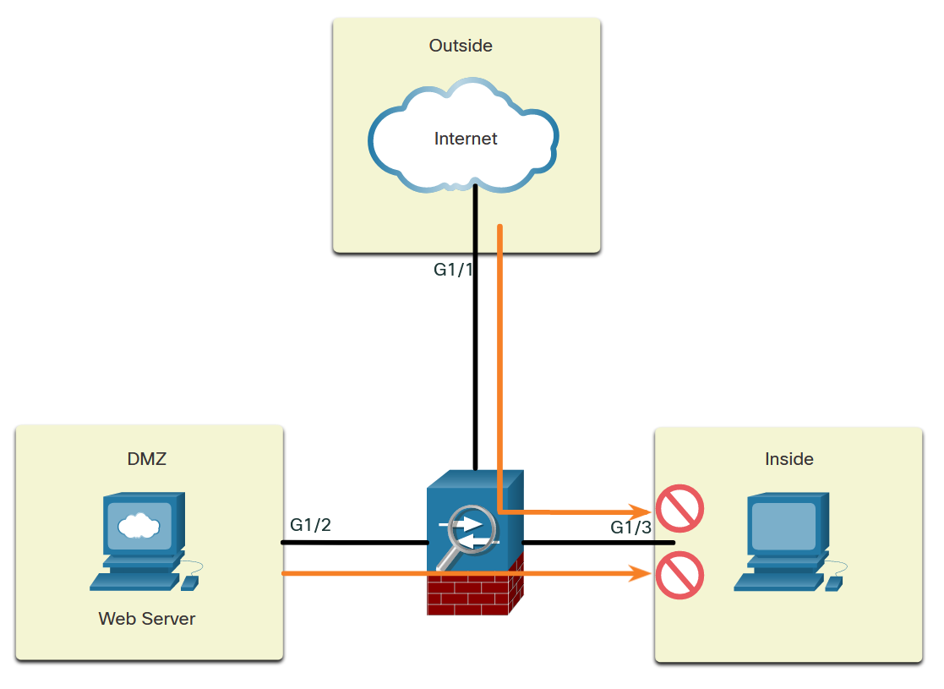
ASA Solutions
Review of Firewalls in Network Design (Cont.)
The figure illustrates how these zones interact for denied traffic:
Traffic originating from the outside network going to the inside network is denied.
Traffic originating from the DMZ network going to the inside network is denied.
Cisco ISRs can provide firewall features by using either the Zone-Based Policy Firewall (ZPF) or by using the older context-based access control (CBAC) feature.

Slide 40
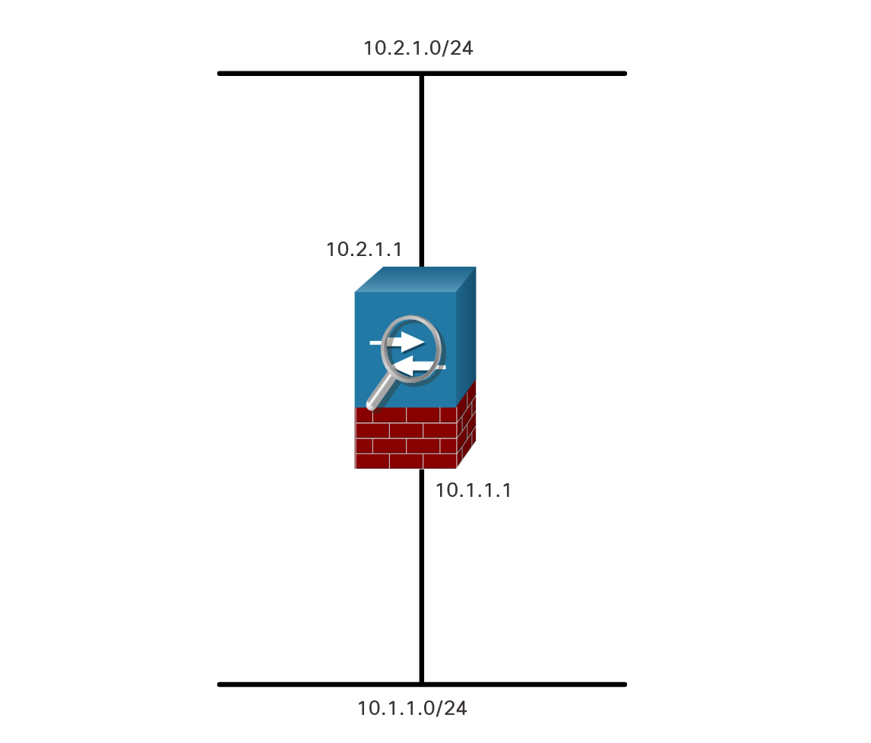
ASA Solutions
ASA Firewall Modes of Operation
Routed Mode
There are two firewall interface modes of operation available on ASA devices: routed mode and transparent mode.
In routed mode, two or more interfaces separate Layer 3 networks, i.e. domains.
In the figure, the ASA is considered to be a router hop in the network and can perform NAT between connected networks. Routed mode supports multiple interfaces. Each interface is on a different subnet and requires an IP address on that subnet. The ASA applies policies to flows as they transit the firewall.

Slide 41
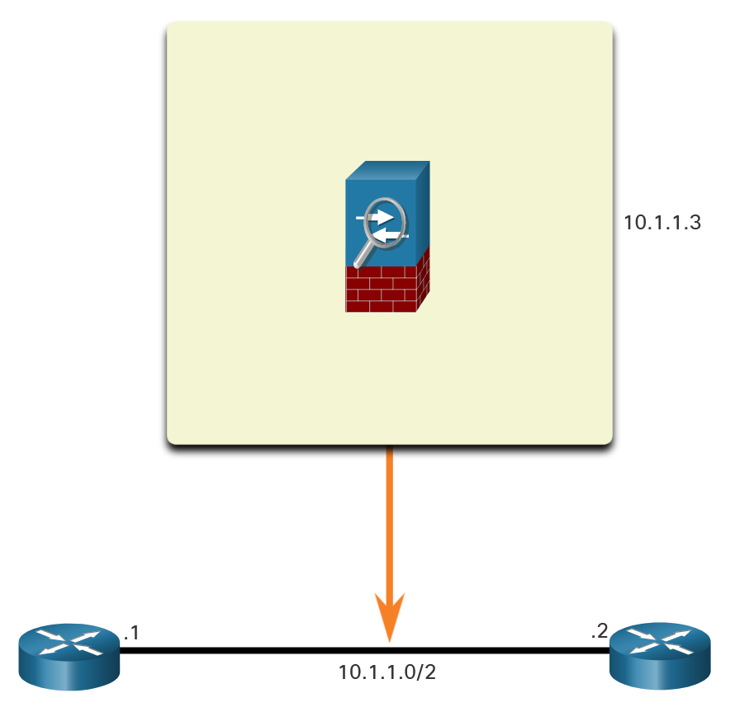
ASA Solutions
ASA Firewall Modes of Operation (Cont.)
Transparent Mode
An ASA in transparent mode is often referred to as a “bump in the wire,” or a “stealth firewall” because the ASA functions like a Layer 2 device and is not considered a router hop. In the figure below, the ASA is only assigned an IP address on the local network for management purposes. This mode is useful to simplify a network configuration, or when the existing IP addressing cannot be altered. However, the drawbacks include no support for dynamic routing protocols, VPNs, QoS, or DHCP Relay.
Notes:
Key points about transparent mode:
The ASA does not require an IP address on its interfaces.
It operates as a "bump-in-the-wire" device, transparently forwarding traffic without modifying the IP addresses.
It can be inserted into an existing network without changing the IP addressing scheme.
Transparent mode is useful when you want to add security to an existing network without changing its architecture or when you need to bridge two separate networks.
The ASA requires IP addresses assigned to its interfaces.
It performs routing functions and maintains routing tables.
It can enforce security policies based on IP addresses, ports, protocols, and other Layer 3 and Layer 4 information.
Routed mode is commonly used when the ASA is the gateway between different network segments and needs to provide routing and security services.

